Slide 1
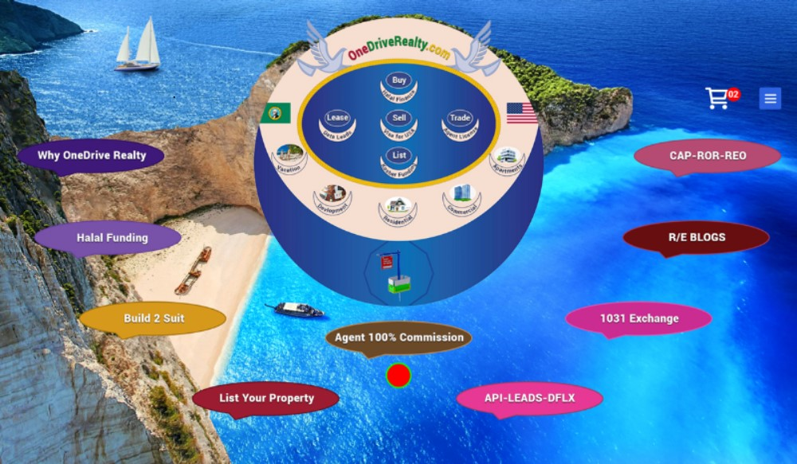
Notes:
This how the home/landing page upper panel should be designed and pixel coded. The 9 Flash Menu Item colors mix should be of Royal Colors Codes.

Slide 2
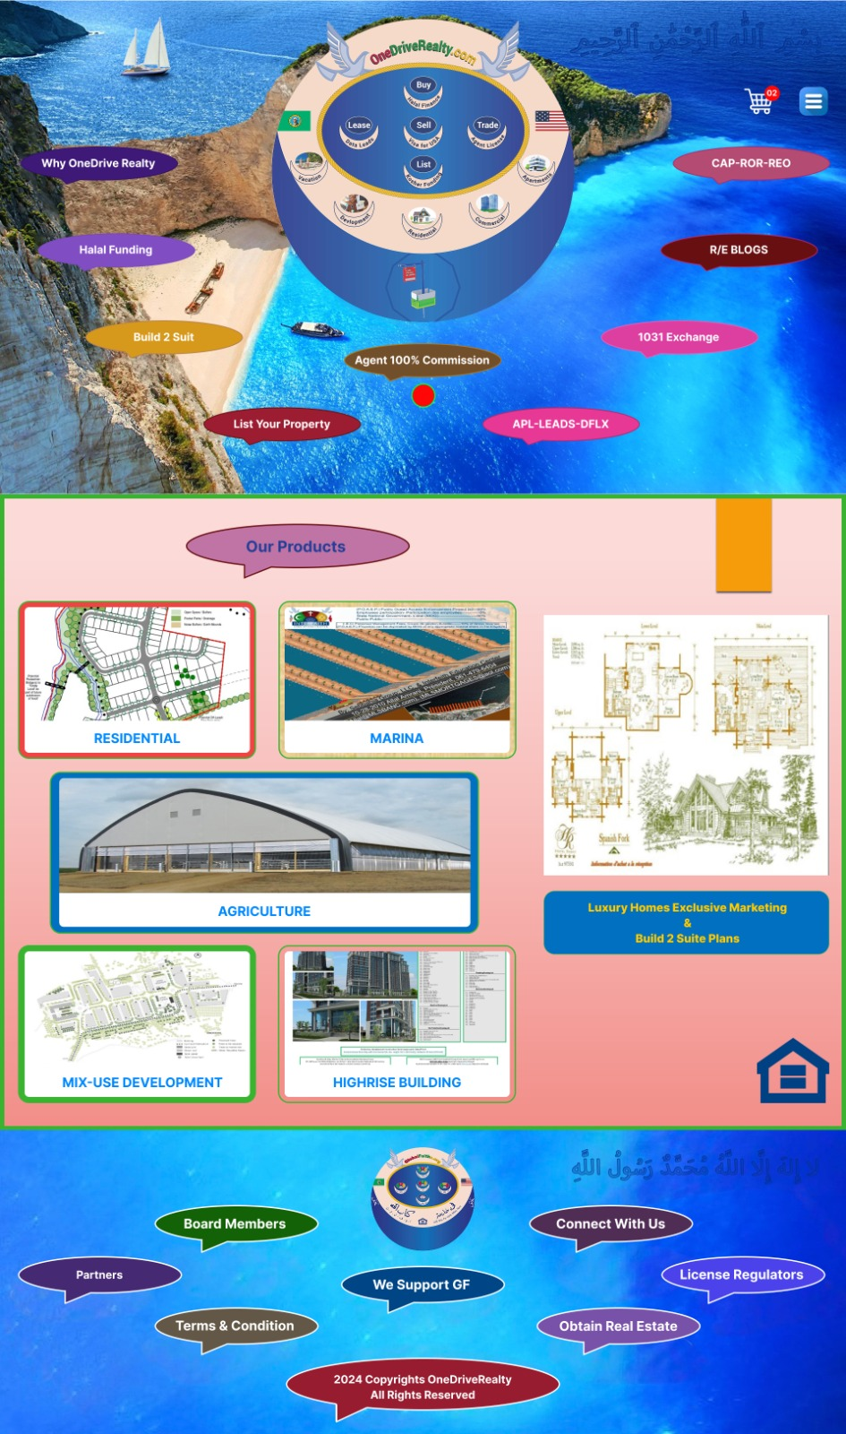
Notes:
This is the home-landing page 3 panels presentation. Each of the 6 product panels will have redirection-hyperlink project video/flip e-book presentation and each presentation will have hyplerlink click to add to card for purchase.

Slide 3
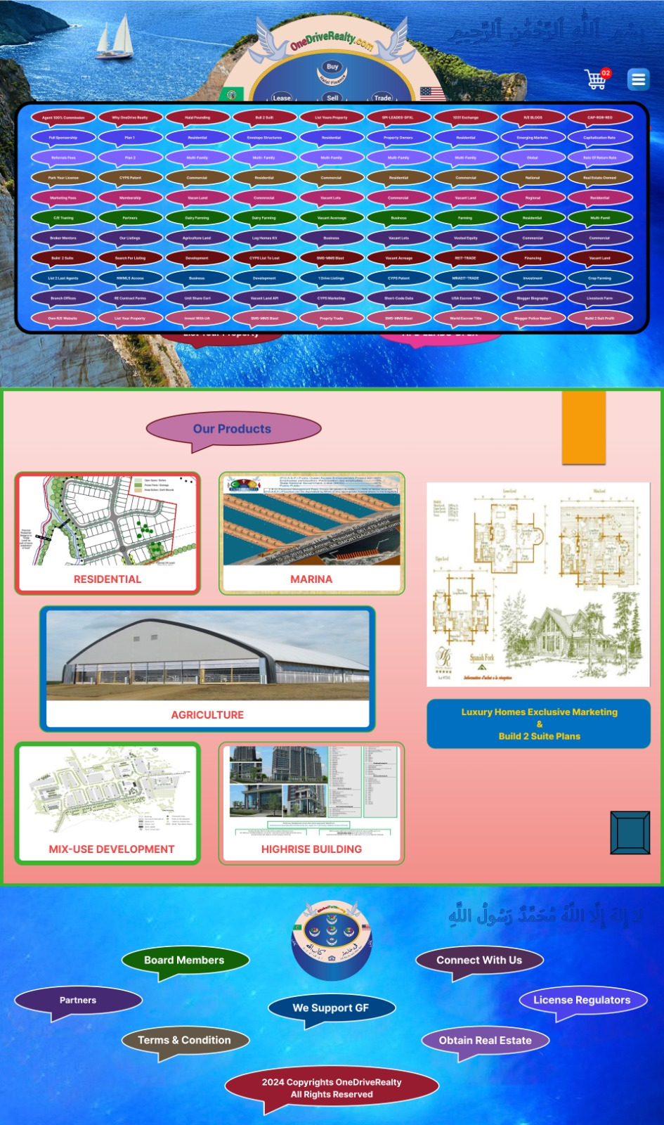
Notes:
This is the same home-landing page example for when a visitor click on the small hamburger menu icon, it will show the entire hamburger menu drop down so visitor can see every product and services the Website present and each of the hamburger menu Item will be a hyperlink-redirection to the panel-page information. The bottom panel flash menue items should be added to the hamberger menu with perfect design on the bottom of the hamburger menu.

Slide 4

Notes:
The Arabic text KALIMA should be designed and coded as transparent as an abstract readable image that must embedded-sandwiched between the ocean water, and it must be on the upper and lower panel perfect.

Slide 5
Notes:
This how I came up with the hamburger drop down flash menu creative Idea that is also a dropdown menu for each of the 9 pages titles on the upper panel. Each menu if clicked by the visitor will show exactly the products-services associated with the menu. Ang again majority of dropdown link information is the same.

